Slide 1
Launching Jupyer Notebook

Slide 2
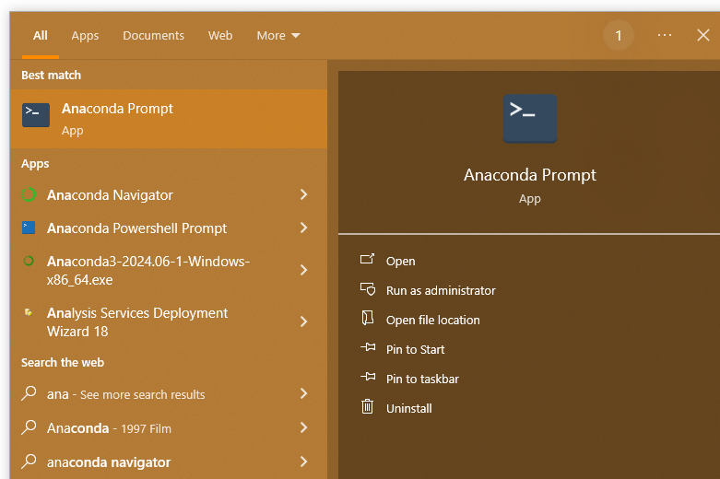
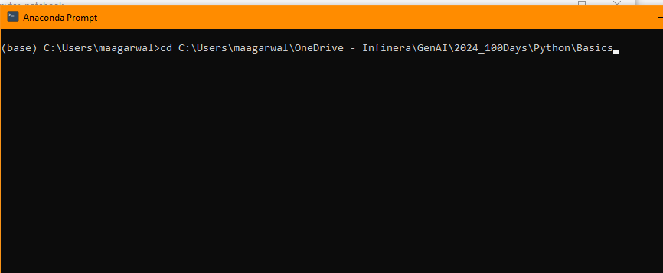
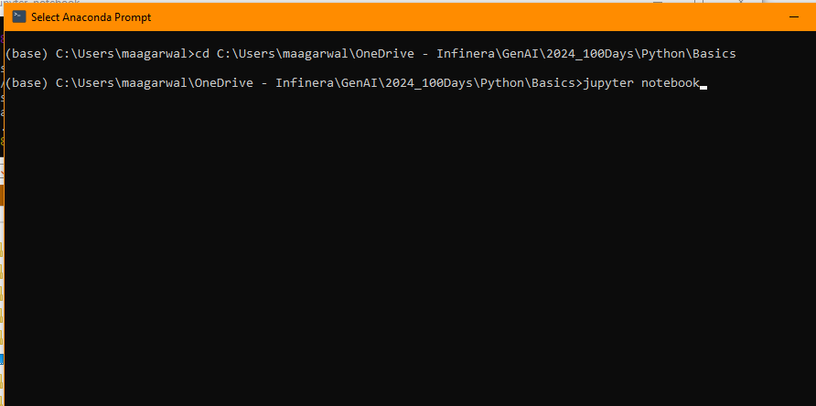
STEP1: Open anaconda prompt
STEP2: cd to desired directory
STEP3: Launch jupyter notebook

